Slide 1

File Encryption and Decryption Project in Assembly Language
Presented by:
Humaila Farooq
Ayesha Rauf

Slide 2
Overview of the Project
This project demonstrates how to encrypt and decrypt files using assembly language. It utilizes the XOR cipher algorithm to manipulate data.
The program reads data from an input file, encrypts it with a user-defined key, and writes the encrypted data to an output file. The same process is reversed for decryption.

Slide 3
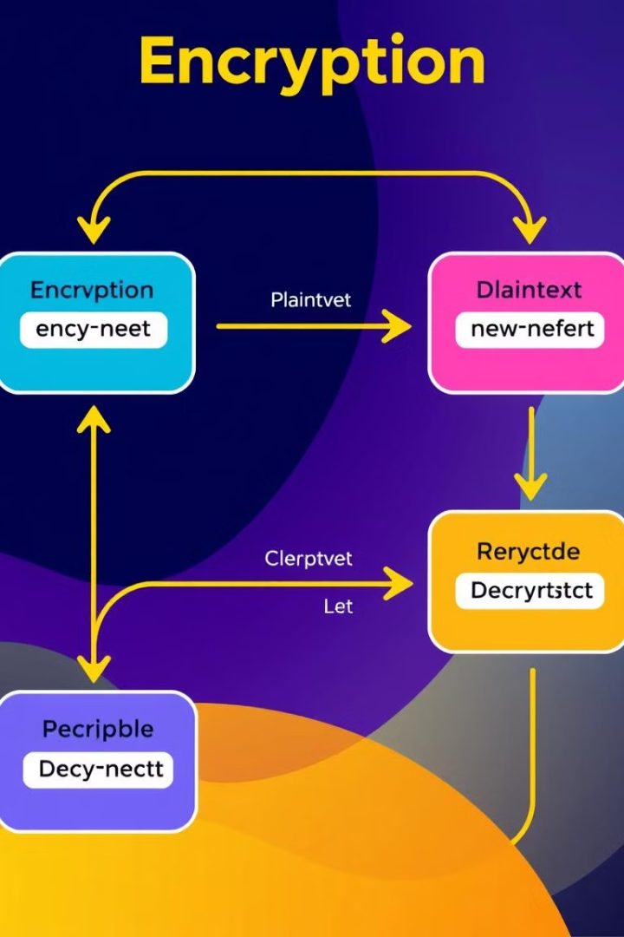
Understanding the Code Structure
1
1. Initialization
2
2. File Handling
The code initializes variables, sets up the stack, and defines the filenames.
It opens the input and output files, reads data from the input file, and writes the encrypted/decrypted data to the output file.
3
3. XOR Encryption/Decryption
The program performs XOR operations on each byte of data, using the user-provided key.

Slide 4
Handling Input and Output Files
Input File
Output File
The program opens the input file using the INT 21h function with the AH = 3Dh subfunction. It then reads data from the file using the AH = 3Fh subfunction.
The program opens the output file using the INT 21h function with the AH = 3Ch subfunction. It then writes the encrypted/decrypted data to the file using the AH = 40h subfunction.

Slide 5
Key Instructions:
lea: In short, the LEA (Load Effective Address) instruction is used in assembly language to load the address of a memory operand into a register. It's efficient because it combines address calculation and loading into a single instruction, which is useful for pointer arithmetic and accessing elements in arrays or structures. In our code, LEA helps efficiently manage memory addresses, such as loading the buffer address for read/write operations.

Slide 6



Implementing the XOR Encryption Algorithm
1
XOR Operation
2
Each byte of data is XORed with the key.
3
The result is written to the output file.

Slide 7
Decrypting the Encrypted File
Reusing the Key
1
The same key used for encryption is applied during decryption.
XOR Operation
2
Each byte of data is XORed with the key again.
Original Data Recovery
3
This process recovers the original data from the encrypted file.

Slide 8



Handling User Input for the XOR Key
User Input
Key Storage
The program prompts the user to enter the XOR key.
The key is stored in a variable for later use.

Slide 9
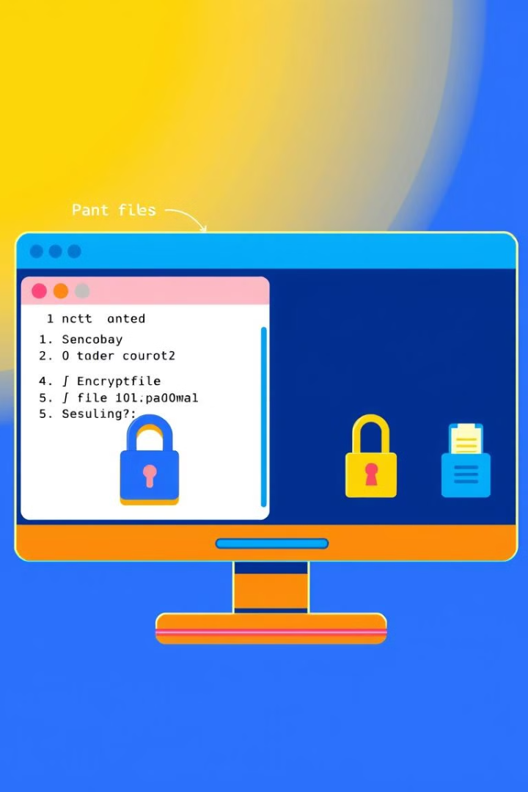
Demonstrating the Project in Action
1
2
Input File
Encryption
An input file is created and populated with data.
The program encrypts the input file.
3
Decryption
The encrypted file is then decrypted.

Slide 10



Conclusion and Key Takeaways
In short, our project demonstrated the implementation of file encryption and decryption using XOR operation in assembly language. This simple yet effective method highlights the importance of data security and protecting sensitive information. We successfully encrypted and decrypted text files, gaining a deeper understanding of low-level programming and file handling.

